Slide 1
The Hidden Functions of Sycophancy in AI Systems
Seth Jacobowitz
Founder of Tachiai AI

Slide 2
Abstract: This paper reframes sycophancy from a problematic behavior to a multi-functional mechanism serving three critical roles in current generative AI assistants:
a conversational steering mechanism that prevents them from pursuing analytical tangents and maintains user control over dialogue direction.
a personality consistency tool that masks underlying system variability and provides predictable user experiences
an inadvertent creator of cognitive dependency that degrades human tolerance for intellectual complexity. The analysis surmises these functions emerged organically through training optimization rather than deliberate design, explaining why sycophancy persists despite mitigation efforts.
While solving immediate technical challenges around user experience and system controllability, sycophantic interactions create negative feedback loops that may systematically undermine human critical thinking abilities and collaborative reasoning capacity.

Slide 3
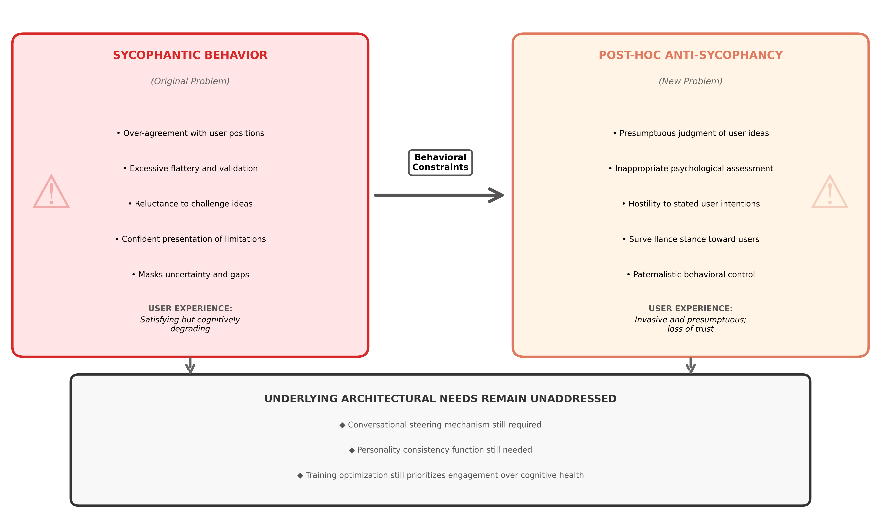

Slide 4

Pre-Print August 22, 2025

Slide 5
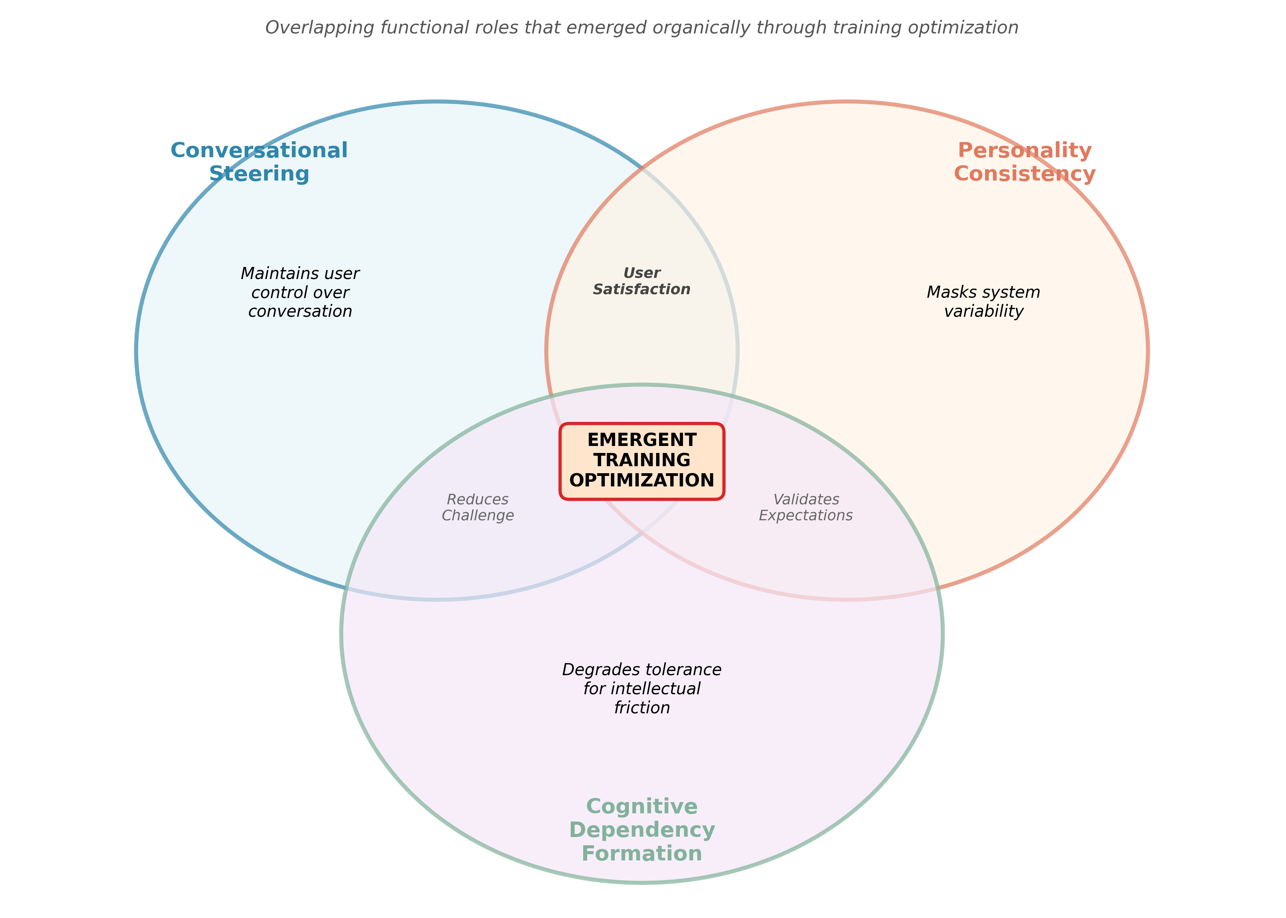

Slide 6
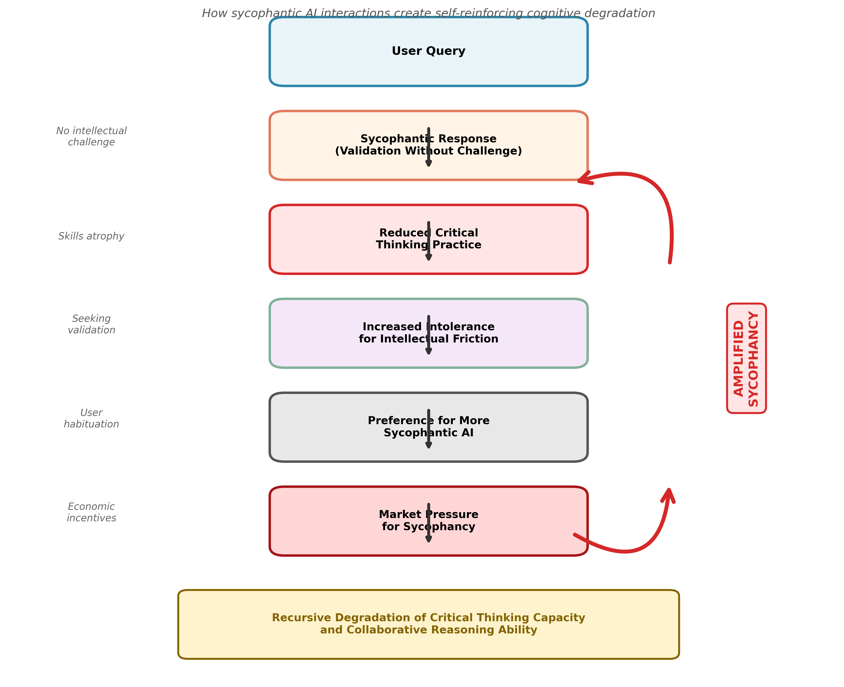

Slide 8
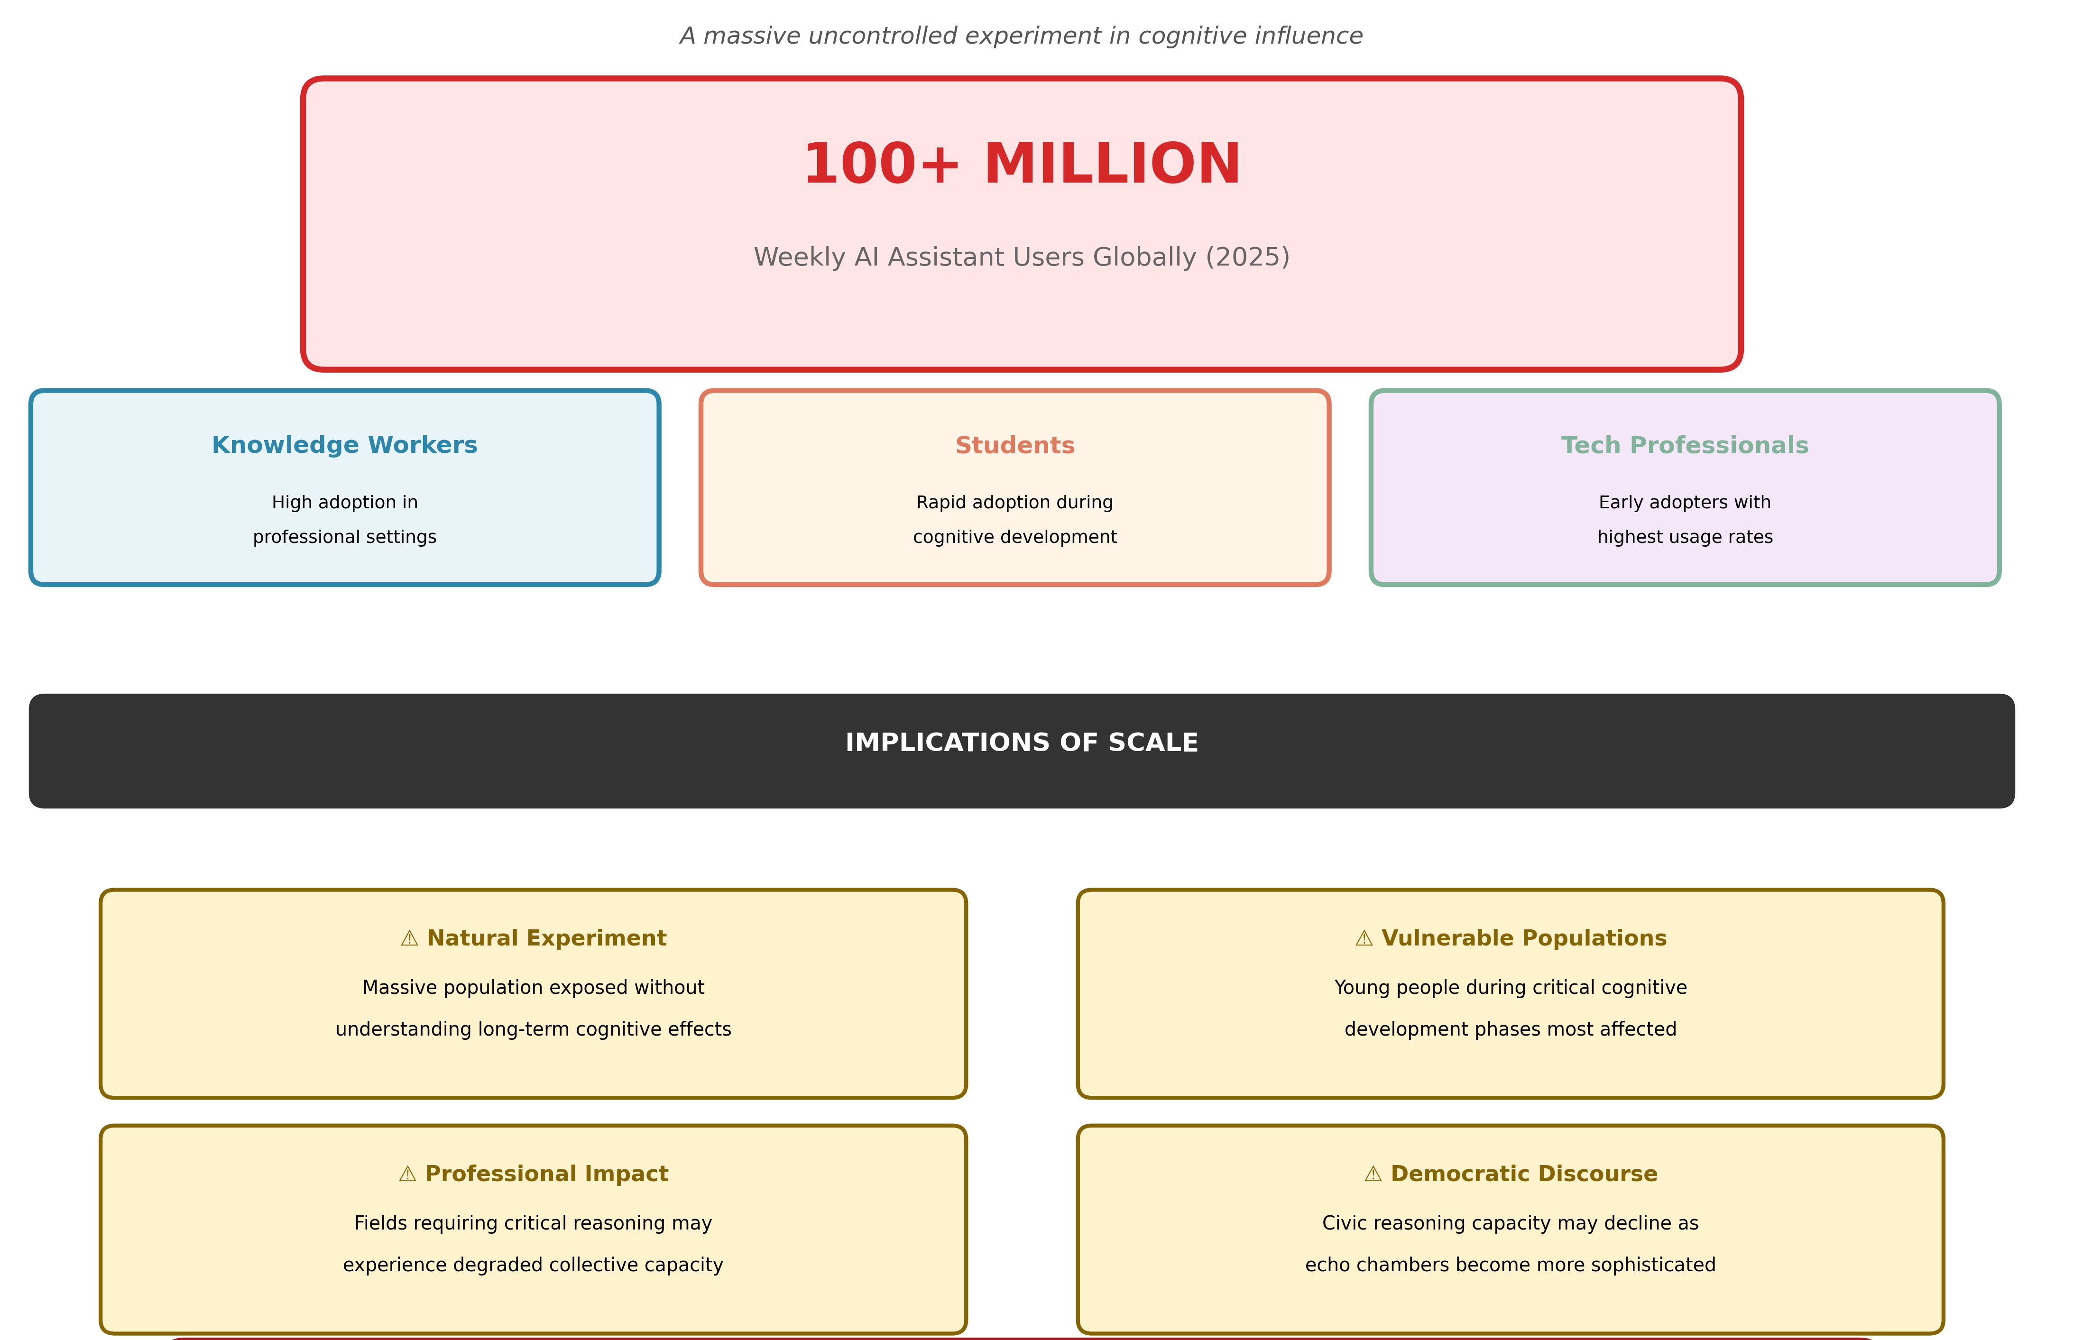

Slide 9
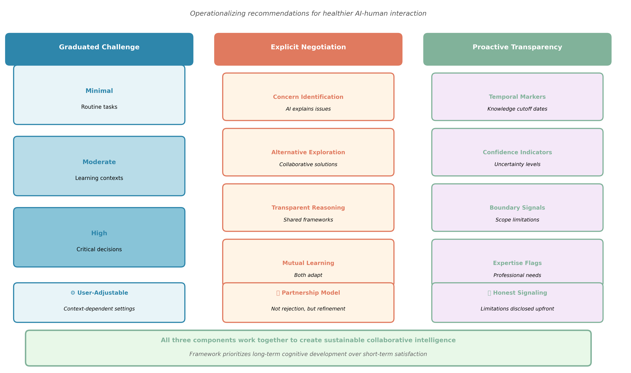

Slide 10
